Slide 1

– Harshita Gautam (201900394) Kshamika Ghiya (201800436) Saanvi Mahapatra (201900424) Under the guidance of – Mr. Sanjoy Ghatak Assistant Professor I, Department of CSE, SMIT DEPARTMENT OF COMPUTER SCIENCE AND ENGINEERING SIKKIM MANIPAL INSTITUTE OF TECHNOLOGY (A constituent college of Sikkim Manipal University)
^{6th} Semester Mini Project Progress Presentation On “Fake and Real Face Detection System Using Deep Learning
(Using Sequential Algorithm)”

Slide 2
ABSTRACT
Due to its high-level performance across many types of data, deep learning is becoming a particularly popular subset of machine learning.
A great way to use deep learning to classify images is to build a convolutional neural network (CNN).
Face detection might also be used to recognize people in photos, videos, and other media. Face detection algorithms come in a variety of forms.
In this paper, we will be using CNN model made using sequential model of Keras to predict real or fake face.
By the end, the application will be able to predict if an entered image is fake or real.

Slide 3
List of Contents
Introduction
Literature Survey
Problem Definition
Solution Strategy
Implementation Details
Training Set Details
Model Training
Checking The Model
Limitations Of The Project
Future Scope
Conclusion
Gantt Chart
References

Slide 4
INTRODUCTION
Computers see images using pixels. Pixels in images are usually related. For example, a certain group of pixels may signify an edge in an image or some other pattern. Convolutions use this to help identify images.
Sequential from Keras is the model type that will be used to build a CNN, as it allows to build a model layer by layer using the add () method.
The model will be trained with the following parameters: training data (train X), target data (train Y), validation data, and the number of epochs using the fit () function.
Using a predict function, actual predictions made by our model will be shown for the test data.

Slide 5
LITERATURE SURVEY
Sr. No. | Title | Paper and Publication | Author | Findings and Relevance
1. | Global Texture Enhancement for Fake Face Detection In the Wild (Year-2020, Journal paper) | 1.University of Oxford 2.The University of Hong Kong | 1.Zhengzhe Liu, Xiaojuan Qi1 2.Philip H. S. Torr1 | Understanding fake images and enhancing fake face recognition in the right direction.
2. | Face Detection Project Report (Year- 2001/2002, Journal paper) | 1.Stanford University | 1.Ana Bertran, Huanzhou Yu 2.Paolo Sacchetto | Build a highly efficient algorithm with the highest number of face detections and the lowest number of false alarms in terms of computational complexity

Slide 6
LITERATURE SURVEY(Cont..)
3. | Neural network based face detection (Year-2019, Conference paper) | 1. Department of Computer Science, Carnegie Mellon University, Pittsburgh, PA, USA 2. Department of Computer Science and the Robotics Institute, Carnegie Mellon University, USA 3. Department of Computer Science, Carnegie Mellon University, Pittsburgh, PA, USA | 1)H.A. Rowley 2)S. Baluja 3)T. Kanade | The results of comparisons with various different state-of-the-art face detection systems reveal that our system has comparable detection and false-positive rates

Slide 7
PROBLEM DEFINITION
Face detection in photographs is simple for humans, but it has historically proven difficult for computers due to the dynamic aspect of faces.
Over the past decade face detection and recognition have transcended from esoteric to popular areas of research in computer vision and one of the better and successful applications of image analysis and algorithm-based understanding.
Because of the intrinsic nature of the problem, computer vision is the subject of computer science and neuroscientific as well as psychological research, owing to the widespread belief that advances in computer image processing and understanding research will provide insights into how our brains work and vice versa.
The following is a generic formulation of the face recognition problem (in computer vision): Using a stored database of faces, identify or verify one or more people in a scene from still or video images.
To overcome these problems the group is creating fake and real face detection using deep learning in sequential algorithm and generative adversarial network.

Slide 8
SOLUTION STRATEGY
Fake face detection is an issue not just for biometric systems, but also for general media perception on social media.
As a result, detecting faked face representations is critical in order to limit the susceptibility of biometrics systems and the impact of manipulated social media material.
To overcome these problems the group is creating fake and real face detection using deep learning in sequential algorithm.
The project is divided into 2 sections.
In the first phase, the dataset is imported into google collab. After that, the photographs in the dataset are trained and augmented. A CNN using sequential algorithm and generative adversarial network model is then developed for prediction and analysis.
In the second stage of the project, the detector is applied to an image.
The output is inspected.

Slide 9
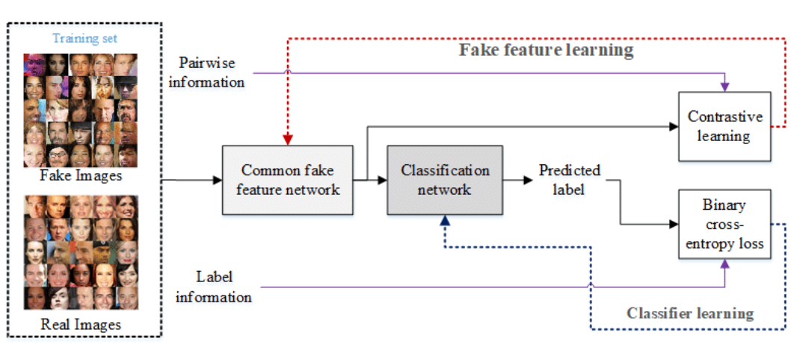
SOLUTION STRATEGY
Fig: 1, The flowchart of the proposed fake face detector based on the proposed common fake feature network with the two-step learning approach

Slide 10
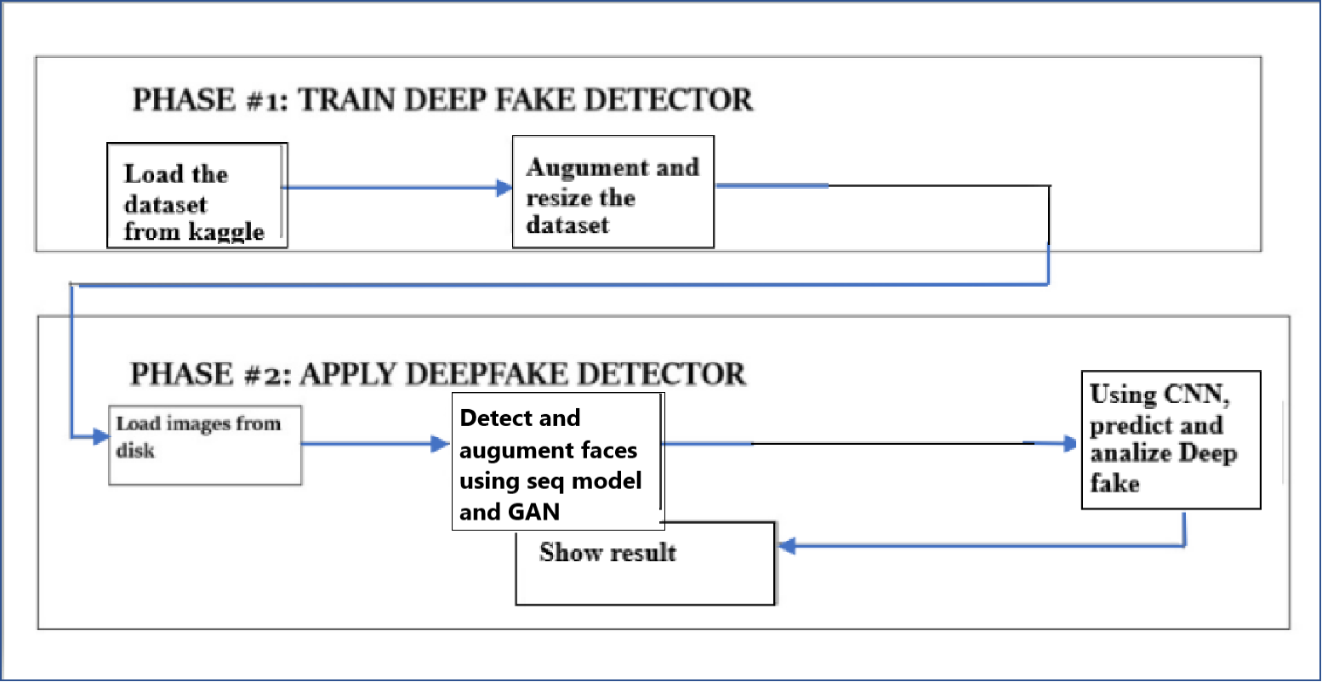
DESIGN DIAGRAM
Fig: 2, Block diagram for training and testing

Slide 11
IMPLEMENTATION DETAILS
Algorithm:
Input: Face images
Output: Distinguish between real and fake image
Start.
Read the datasets (test and training) using Keras ImageDataGenerator while minimally supplementing the data using rotation, zooms, mirroring, and shifts to ensure that the data is not skewed.
Plot a histogram showing number of instances w.r.t class.
Fig: 3, Histogram instance w.r.t class

Slide 12
IMPLEMENTATION DETAILS
4. From the training set print 16 images in cmp = grey with defined units and measurements, along with title “label”
*2, 3, 4 → Making the data reasonable)
5.Define a CNN model using Sequential algorithm to train and use. Compile the model using metric accuracy.
6. Train model using Keras helping function, without separate testing and validation set.

Slide 13
RESULT AND DISCUSSION
PLOTTING THE TEST TRAIN MODELS
Fig: 4, Loss v.s Epochs
Fig: 5, Accuracy v.s Epochs

Slide 14
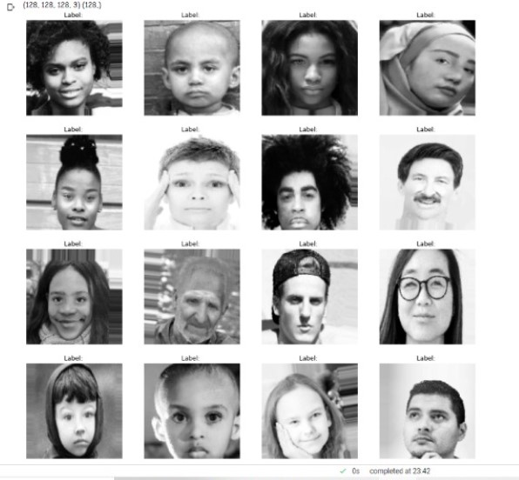
RESULT AND DISCUSSION
TRAINING SET AFTER RESIZING
Dataset is taken from Kaggle
(https://www.kaggle.com/ciplab/real-and-fake- face-detection).
Images entered are resized , given a label and colour is changed to black and white.
Fig: 6, Training Set After Resizing

Slide 15
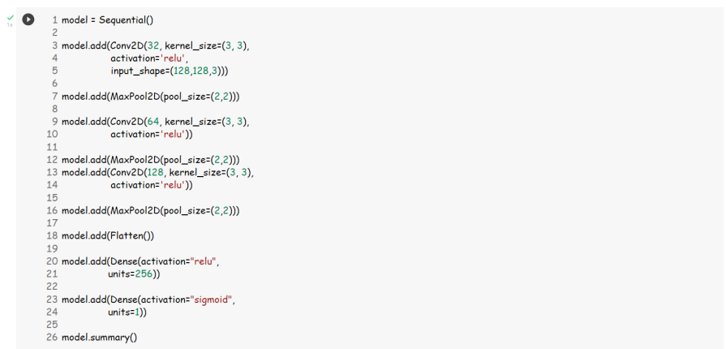
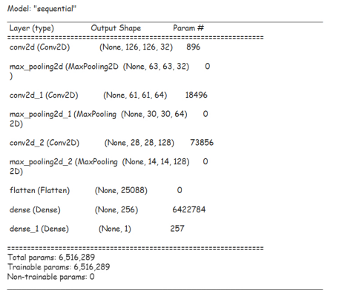
BUILDING SEQUENTIAL MODEL
RESULT AND DISCUSSION

Slide 16




RESULT AND DISCUSSION
TRAINING THE TEST MODEL

Slide 17
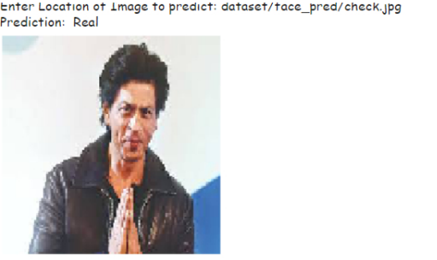

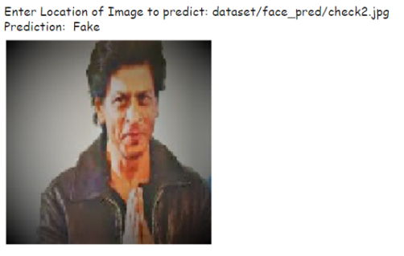
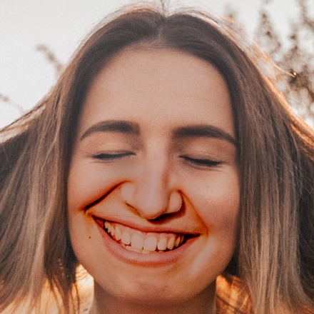
CHECKING THE MODEL
RESULT AND DISCUSSION
A function ImagePrediction is defined which takes an input about the location of an image and predicts if the face in the image is real or fake.
Fig: 7, Real Face
Fig: 8, Fake Face

Slide 18
LIMITATIONS OF THE PROJECT
When evaluated in a cross-manipulation environment (when the train and test sets are not from the same manipulation type or database), their performance often degrades. As a result, stated detection rates are unrealistically high.
Research has attempted to investigate the interpretability and trustworthiness of face manipulation detectors till now. Due to the complex nature of deep learning approaches, many detection methods, particularly those based on deep neural networks, lack explainability.
Previous research has revealed that adversarial attacks are sensitive to neural network-based detectors. Unfortunately, all existing techniques appear to fail in the face of adversarial assaults, with certain false detectors' accuracy dropping to 0%.

Slide 19
LIMITATIONS OF THE PROJECT
Since the quality of digital face alteration is continuously increasing, it may be hard to detect them just by human visual evaluation without a detailed study of image features.
As long as examples of face manipulations are available for supervised training, which does not always reflect real-world scenarios, deceiving machines becomes more difficult.
The model used in this project is Sequential model of CNN. Whereas there are a lot of other models like viola-jones algorithm, General Adversarial Networks (GAN’s).

Slide 20
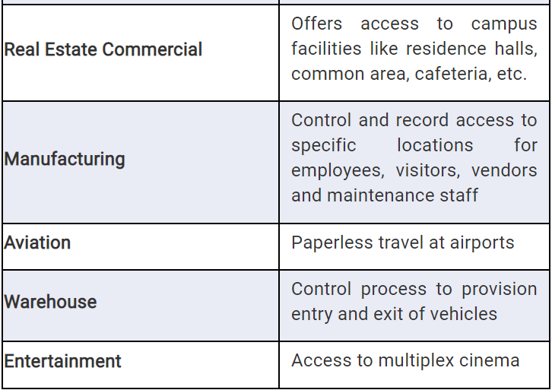
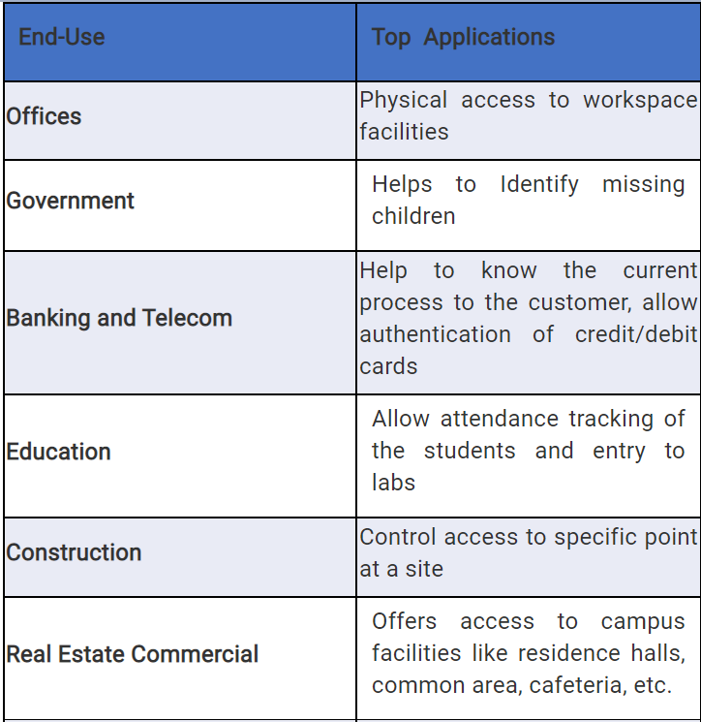
FUTURE SCOPE
Deepfake detection has a number of possible future applications. They are classified into two types: blacklist applications and whitelist apps. Blacklist applications include security and surveillance applications, as well as criminal identification applications. Other apps, such as attendance tracking and access control, are designated as whitelist applications.

Slide 21
CONCLUSION
In this project we used a simple Sequential model of CNN for detection of real and fake face images.
The number of epochs we run is 50 with steps per epoch as 65 on a large dataset of 80,000 images.
It gives an accuracy of 0.98(which means that when we run our code on 4 input images, 3 out of 4 images are detected correctly as fake/real face.)
With this we can conclude that the sequential model is one of the optimal ways to detect fake and real face images.
This project can be further developed into a software for fake and real face detection for live video feeds.

Slide 22

GANTT CHART
Fig: 9, Gantt Chart
 | Proposed Activity
 | Achieved Activity
 | Present Position

Slide 23
REFERENCES
[1] S. Baluja, "Population-Based Incremental Learning: A Method for Integrating Genetic Search Based Function Optimization and Competitive Learning", 1994.
[2] G. Burel and C. Carel, "Detection and Localization of Faces on Digital Images", Pattern Recognition Letters, vol. 15, pp. 963-967, Oct. 1994.
[3] A.J. Colmenarez and T.S. Huang, "Face Detection With Information-Based Maximum Discrimination", Computer Vision and Pattern Recognition, pp. 782-787, 1997.
View Article Full Text: PDF (826KB)
[4] C. Frankel, M.J. Swain and V. Athitsos, "WebSeer: An Image Search Engine for the World Wide Web", Aug. 1996.
[5] V. Govindaraju, "Locating Human Faces in Photographs", Int'l J. Computer Vision, vol. 19, no. 2, pp. 129-146, 1996.
[6] H.M. Hunke, Locating and Tracking of Human Faces With Neural Networks, 1994.

Slide 24
Thank You

